Slide 2
Building business apps like they do in the valley with Angular, Node.js, and more...
Andrew Connell
@andrewconnell
www.andrewconnell.com

Slide 3
Topics
What is Node.js? … and io.js?
Developer Tooling for Node.js
Creating Websites & Web APIs with Node.js
Developing with Node.js
Node for Office & SharePoint Add-ins

Slide 4
What is Node.js?

Slide 5
What is Node.js
Cross platform environment for hosting JavaScript
Facilitates end-to-end JavaScript environment
Ideal for network & I/O based applications
Non-blocking, event driven
Open source
Managed by
Node.js Foundation
Joyent
https://nodejs.org

Slide 6
Who uses Node.js?
Microsoft Azure - http://aconn.me/1HZWEl2
Yammer - http://aconn.me/1Gxy9hL
Walmart - http://aconn.me/1HZWz0w
PayPal - http://aconn.me/1DsFZqx
LinkedIn - http://aconn.me/1NZNs1S
Trello - http://aconn.me/1OjCPsI

Slide 7
Node.js Components
Node
NPM
V8

Slide 8
Node.js vs io.js
Node.js – https://nodejs.org
Managed by Node.js Foundation (+Joyent)
Current (v0.12.2) uses V8 v3.28.73
io.js - https://iojs.org
Forked copy of Node.js in late 2014
Created out of community frustrations with decline in the pace of contributions & releases - http://aconn.me/1NZQvHl
Current version (v2.0.0) uses V8 v4.2
Contains many fixes & features not yet implemented in Node.js
Compatible with NPM
What will the future hold? Yet to be determined!

Slide 9
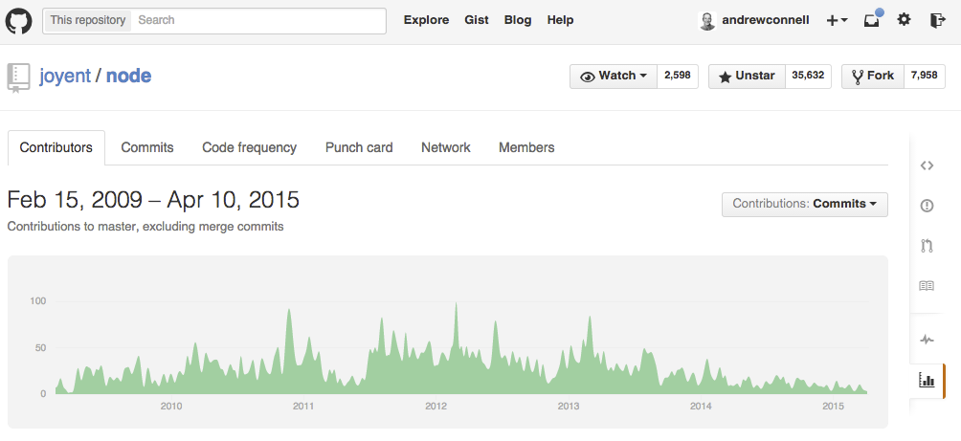
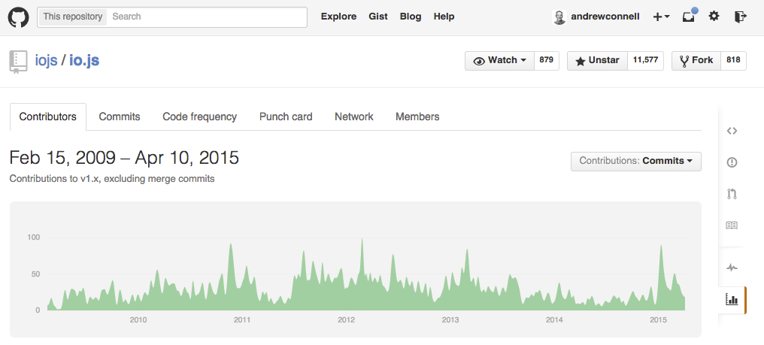

Slide 10
Appeal of Node.js & io.js
One language used from server to client
Same language used in projects & ecosystem around the projects
Build process
Developer tooling
System configuration
Cross platform
Built for network & I/O bound operations

Slide 11
Developer Tooling for Node.js

Slide 12
Node.js Developer Tooling Options
Visual Studio
https://www.visualstudio.com/en-us/explore/node-js-vs
Visual Studio Code
https://code.visualstudio.com
WebMatrix
http://www.microsoft.com/web/webmatrix
WebStorm
https://www.jetbrains.com/webstorm
Brackets
http://brackets.io
Any text editor

Slide 13
Developing Node.js

Slide 14
Node.js for Websites & Web APIs
Connect
Express
MVC
APIs

Slide 15
Connect
HTTP Middleware for Node.js
var app = connect();
Facilitates simple request & response
Extensible HTTP server framework using plugins
Plugins = Middleware
app.use(‘/foo’, function mw(req, res, next){next();});

Slide 16
Express
Minimalist web framework
Built on Connect
Unopionated
Developers write all the plumbing code
Extensible – multiple MVC framework options

Slide 17
MVC Frameworks in Node.js
Jade
Unique HTML shorthand syntax
EJS
Embedded JavaScript
Vash
Similar to ASP.NET’s Razor syntax
Handlebars
Same as client-side syntax

Slide 18
Debugging Node.js Applications
Node --debug
node-inspector
Nodemon
spy.js

Slide 19
Angular & Single Page Apps

Slide 20
What are SPAs?
Responsive web applications that don’t refresh the entire page
Fetch only data & views when needed
Examples
Outlook Web App
Gmail
Trello

Slide 21
Characteristics of SPA Frameworks
Routing
Screen history with navigation
Deep linking
Templated views
Data binding

Slide 22
Angular 1.x or 2.0?
Where are we…
1.3 – current release
1.4 – currently release candidate 1
1.5+ – theme is to help with migration to 2.0
1.x still supported while public interest & use
Angular 2.0
Crazy fast
Evergreen browsers only
Think “ASP.NET WebForms => ASP.NET MVC”

Slide 23

Call to Action
https://dev.office.com
https://nodejs.org
https://iojs.org
https://angularjs.org & https://angular.io
Sample code projects:
https://github.com/andrewconnell/pres-o365-node
https://github.com/andrewconnell/pres-sp15app-ng-spa

